Slide 1
Python Machine Learning

Slide 2
Giving Computers the Ability to Learn from Data

Slide 3
Machine Learning
A subfield of artificial intelligence (AI)
Self-learning algorithms
Deriving knowledge from data in order to make predictions

Slide 4
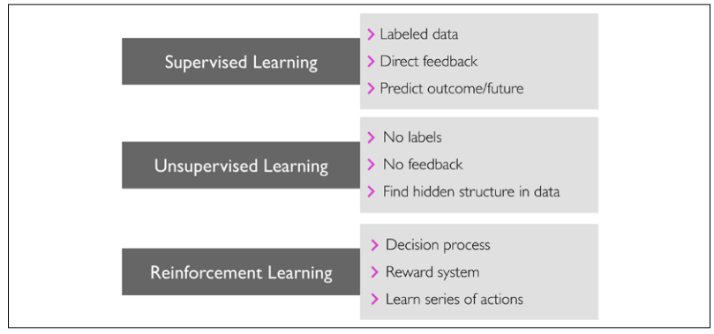
The three different types of machine learning

Slide 5
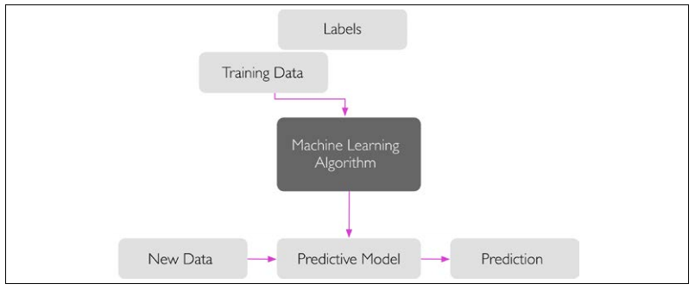
Supervised Learning
Learning a model from labeled training data
Making predictions about unseen or future data

Slide 6
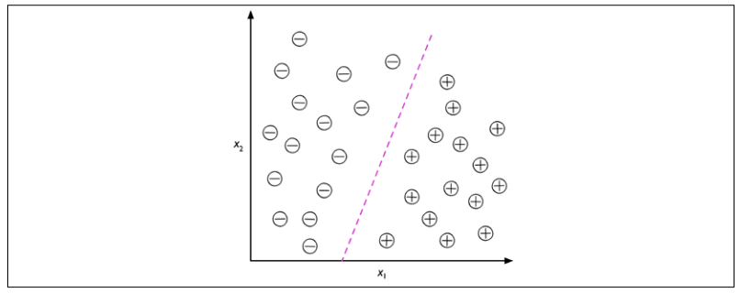
Classification
Predicting the categorical class labels of new instances

Slide 7
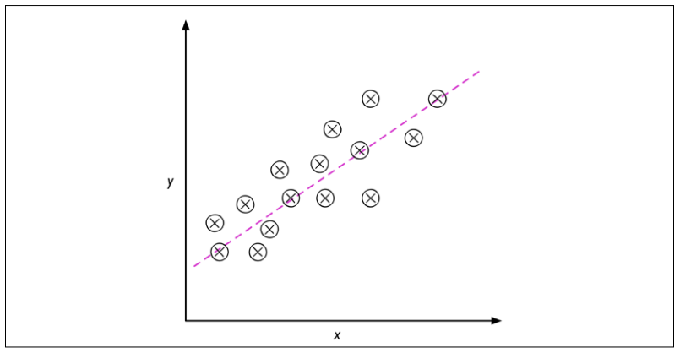
Regression
Prediction of continuous outcomes

Slide 8
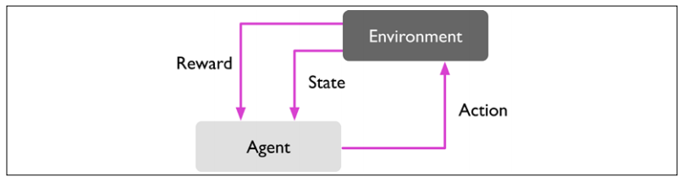
Reinforcement learning
Developing a system that improves its performance

Slide 9
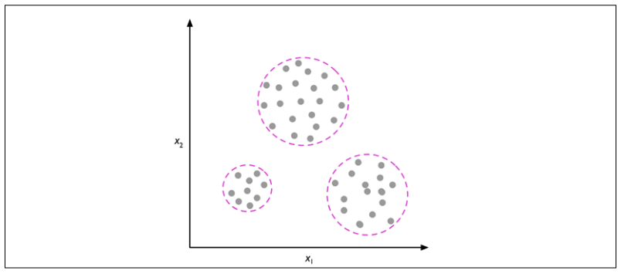
unsupervised learning
Discovering hidden structures

Slide 10
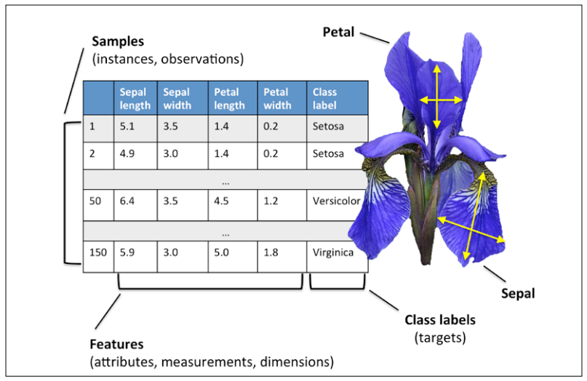
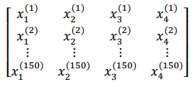

Notation and conventions used in this book

Slide 11
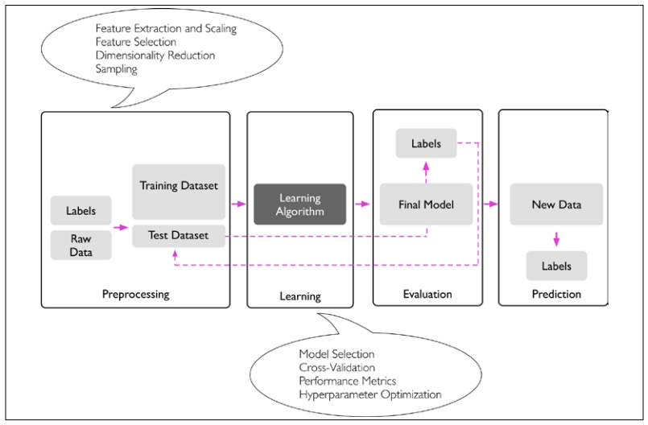
A roadmap for building machine learning systems

Slide 12

Programming Tools
Python $≥$ 3.7
NumPy $≥$ 1.17.4
SciPy $≥$ 1.3.1
scikit-learn $≥$ 0.22.0
Matplotlib $≥$ 3.1.0
pandas $≥$ 0.25.3
Pycharm IDE

